Slide 1

PRESENTER: ASHWATH SURESH HEGDE

Slide 2
INTRODUCTION
People usually tend to go out with friends or roommates to restaurants or shopping or for movies or travel. At the end, always a single person ends up in paying for every individual and all the other people have to pay him “later”.
The person who has to be paid has to ask others to pay their share within certain period and also each individual has to remember the share owed by him for this transaction, which would be a very tedious job.

Slide 3
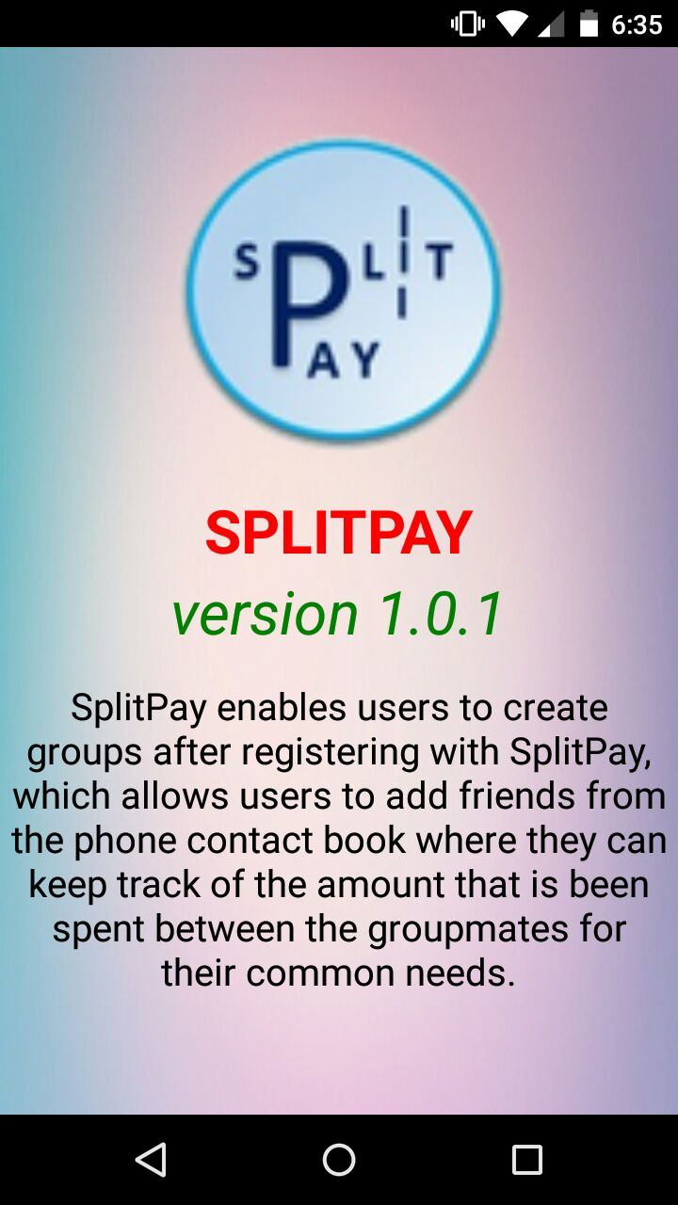
INTRODUCTION (contd…)
SplitPay can be used to maintain accounts and make payments between people using their credit or debit card.
Users can maintain accounts and pay money they owe without any hassles.

Slide 4
FEATURES
Login Activity.
Registration of new user.
Registration form validation.
Group Creation.
Adding member to the selected group.
Adding item details and amount spent on item.
Split the amount between all the members of a selected group.
Member due amount payment.
SMS notification.
Logout Activity.

Slide 5
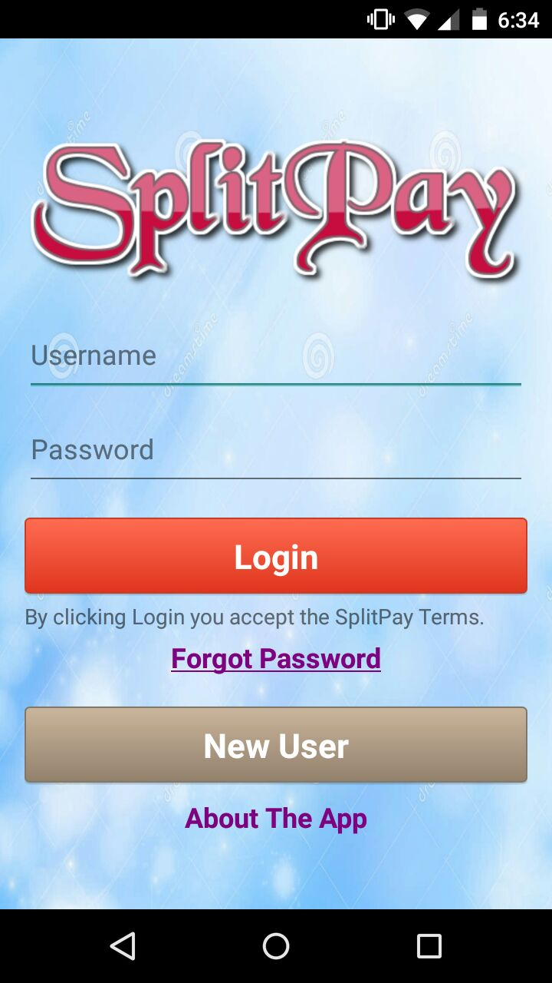
LOGIN ACTIVITY
The login screen of the SplitPay application with the implementation of Forgot Password.

Slide 6
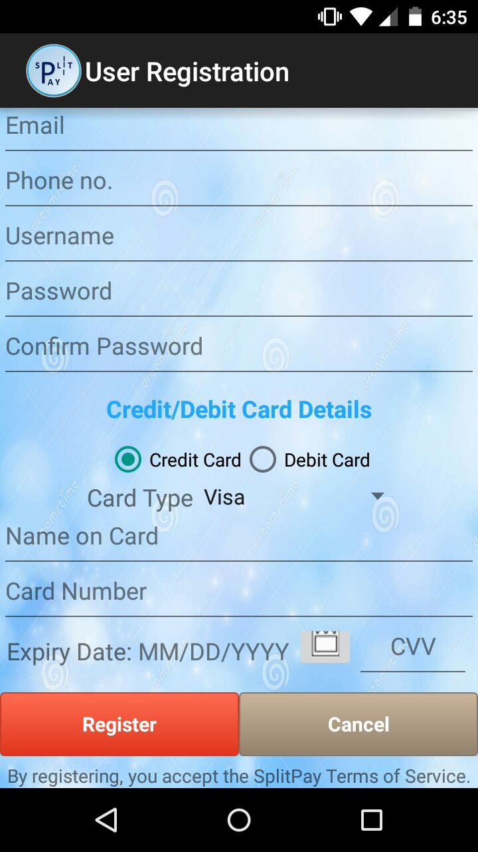
USER REGISTRATION
The registration screen allows users to create a new account for the application.
Takes various information like name, email, password and card details of the user.

Slide 7
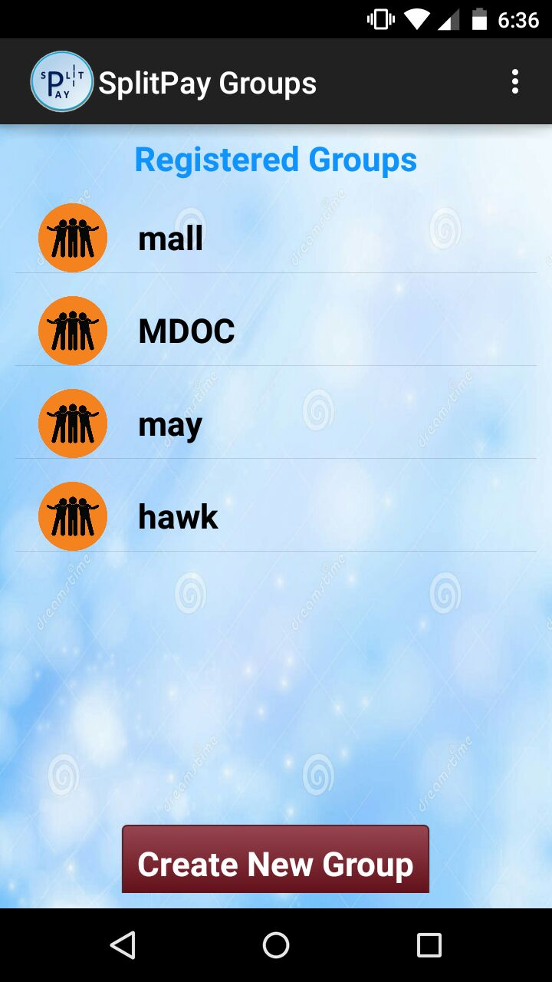
CREATION OF GROUP
User can create a new group.
When the user clicks on the group he will be redirected to the add members screen.

Slide 8
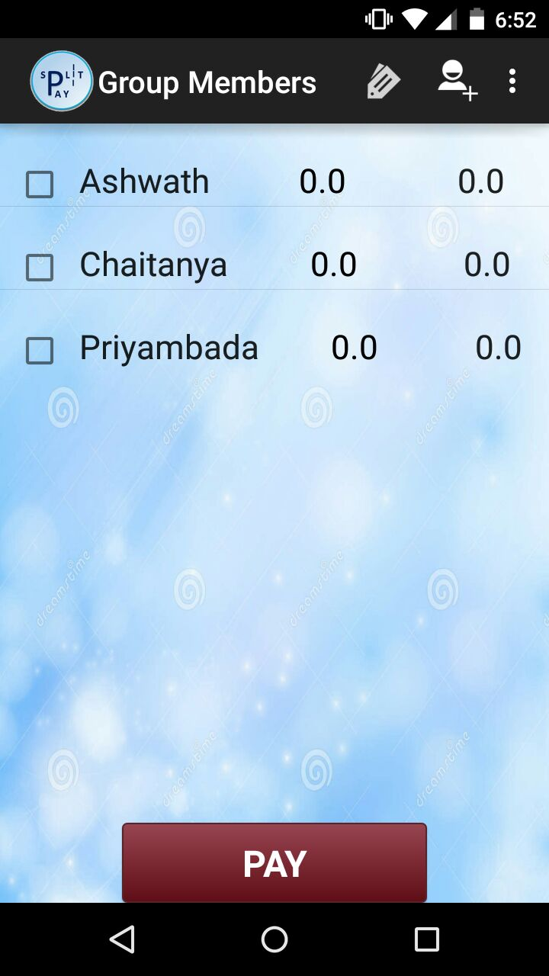
ADDING MEMBERS TO THE GROUP
The member are added to the group by accessing name and phone number from phone contact book.

Slide 9
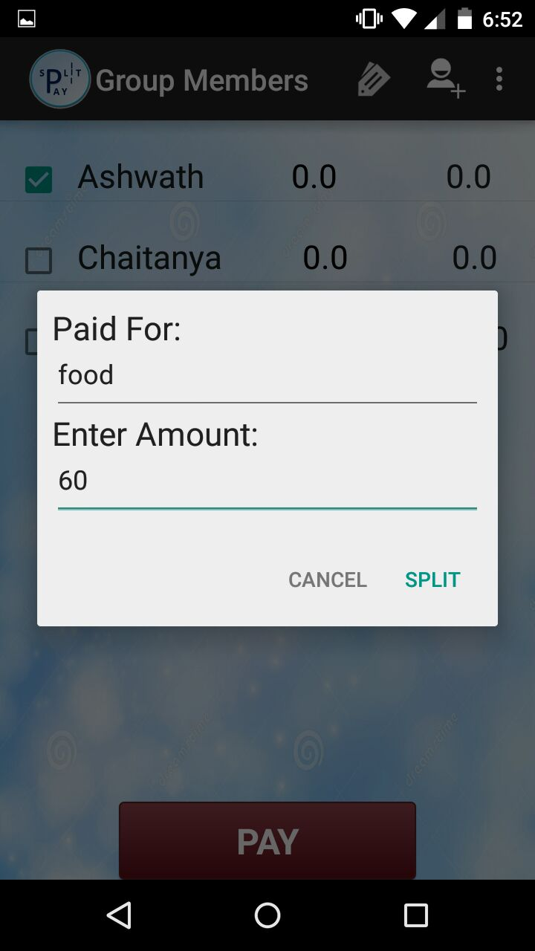
ADDING ITEM AND AMOUNT DETAILS
User will enter the amount and item details in item dialogue Box.

Slide 10

SPLIT THE AMOUNT
On the add item dialog box the user clicks on the split button.
The amount owed and amount paid for that item is calculated
The total amount owed is shown in red if it is $0.0.

Slide 11
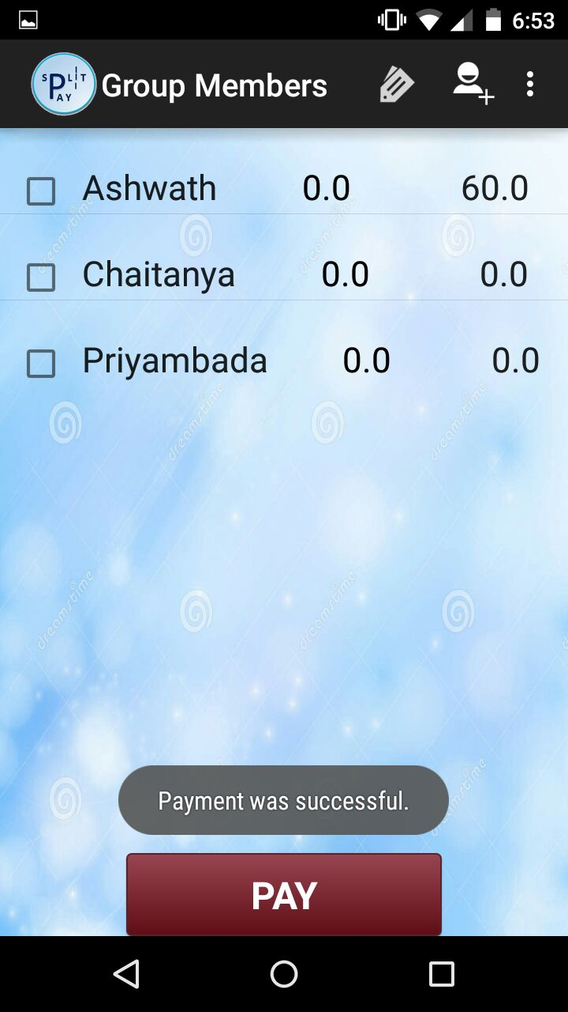
PAYMENT
Successful payment is done when “PAY” button is clicked with one or more members selected and suitable message is displayed.

Slide 12
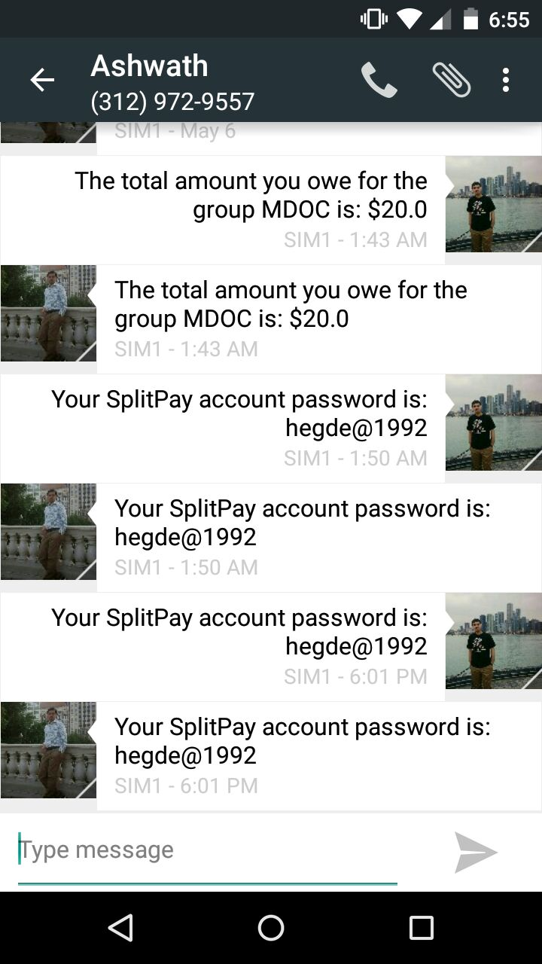
SMS NOTIFICATION
SMS Notification for Forgot password is implemented.
Members whose total amount owed is greater than $0.0, are notified by a SMS.

Slide 13
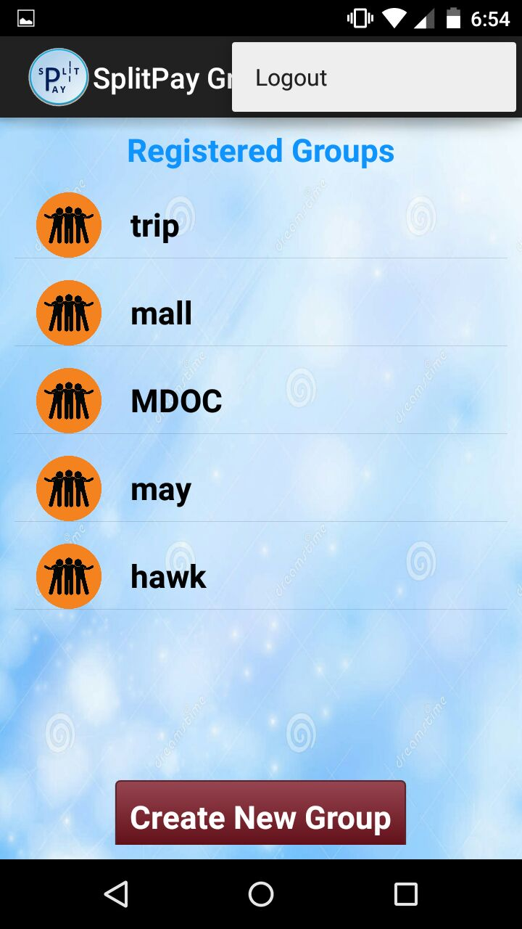
LOGOUT ACTIVITY
The user will be logged-out of the application and will be redirected to login screen.

Slide 14
THANK YOU !!
QUESTIONS ?

